Slide 1
Elementary Statistics – Principles of Confidence Intervals
Dr. Ab Mosca (they/them)
Slides based off slides courtesy of Kaitlyn Cook (https://www.smith.edu/people/kaitlyn-cook)

Slide 2
Plan for Today
Confidence Intervals
Random variables
Sampling distributions

Slide 3
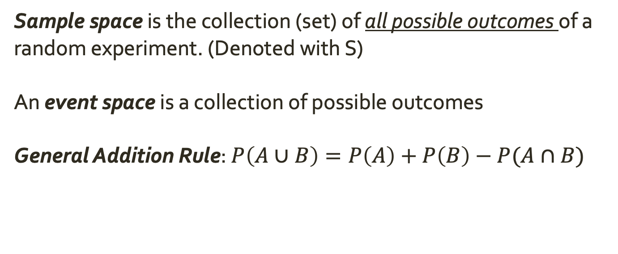
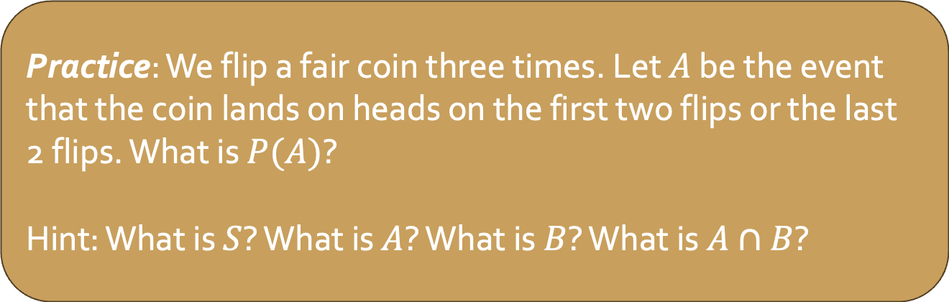
Warm Up: Probability
Sample space is the collection (set) of all possible outcomes of a random experiment. (Denoted with S)
An event space is a collection of possible outcomes
General Addition Rule: $P\left(A∪B\right)=P\left(A\right)+P\left(B\right)−P(A∩B)$
Practice: We flip a fair coin three times. Let $A$ be the event that the coin lands on heads on the first two flips or the last 2 flips. What is $P(A)$?
Hint: What is $S$? What is $A$? What is $B$? What is $A∩B$?
Notes:
S = {(H,H), (H, T), (T,H), (T, T)}.
A = {(H,H), (H, T)}.

Slide 4
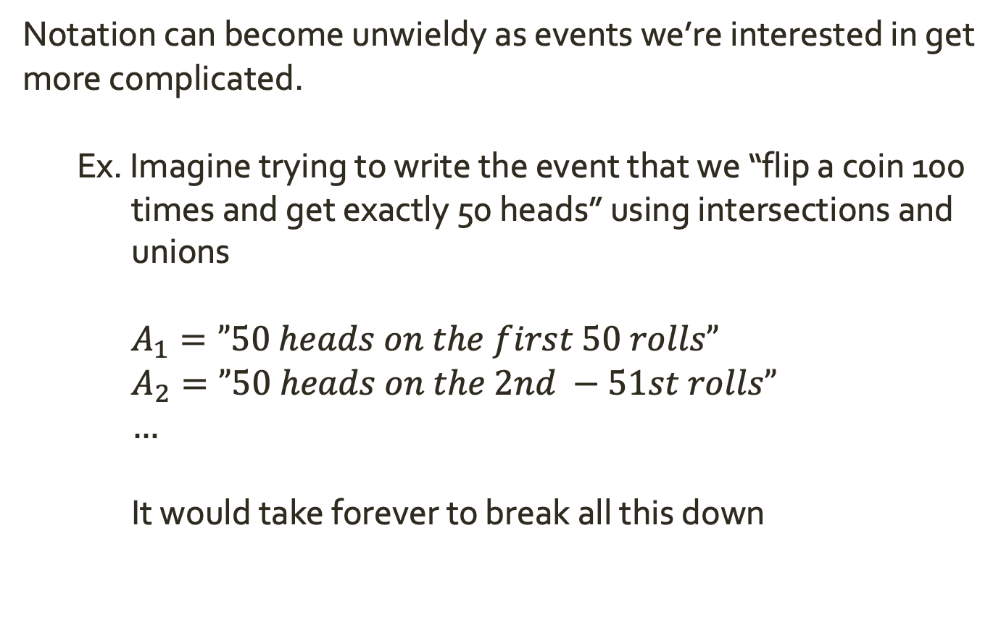
Random Variables
Notation can become unwieldy as events we’re interested in get more complicated.
Ex. Imagine trying to write the event that we “flip a coin 100 times and get exactly 50 heads” using intersections and unions
$A_{1}=”50 heads on the first 50 rolls”$
$A_{2}=”50 heads on the 2nd −51st rolls”$
$…$
It would take forever to break all this down

Slide 5
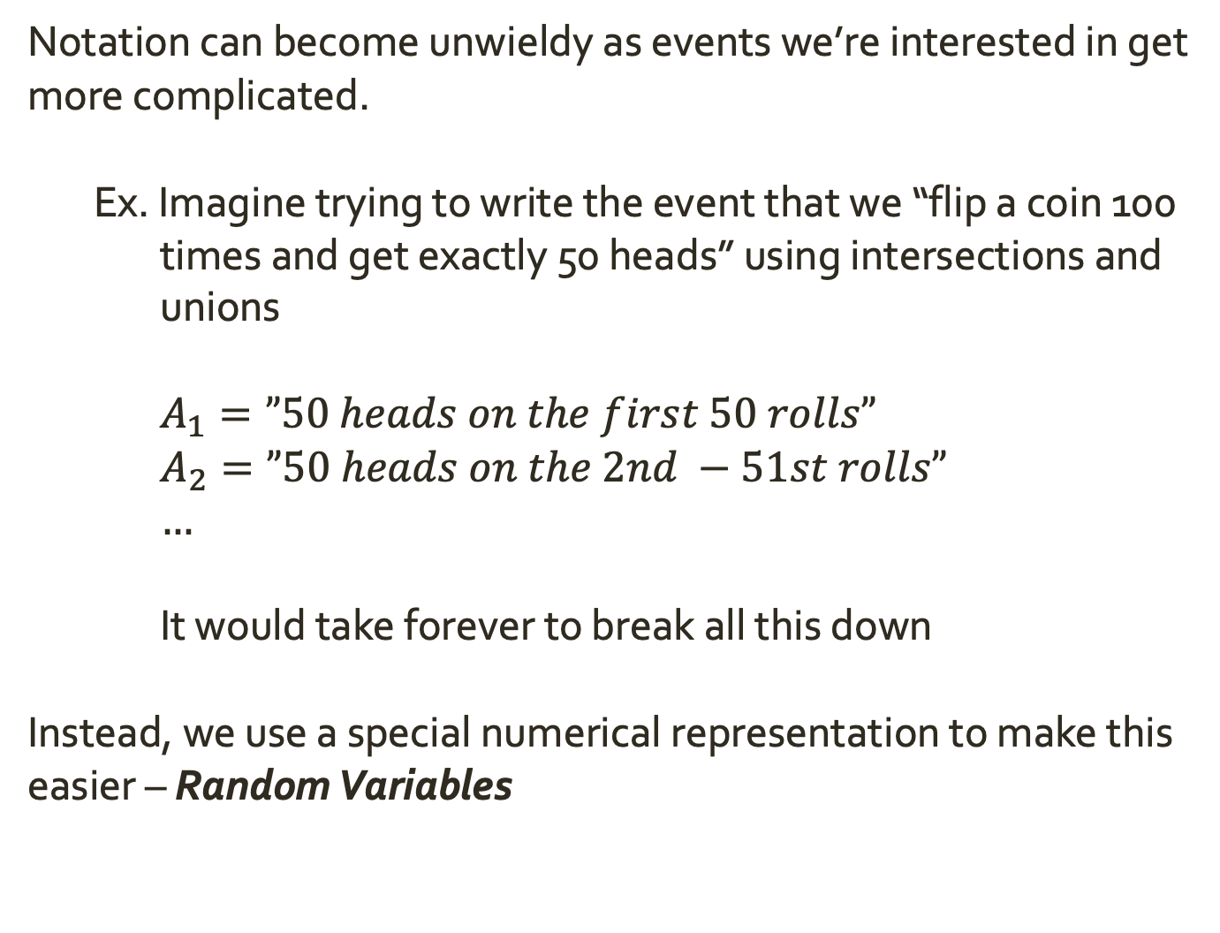
Random Variables
Notation can become unwieldy as events we’re interested in get more complicated.
Ex. Imagine trying to write the event that we “flip a coin 100 times and get exactly 50 heads” using intersections and unions
$A_{1}=”50 heads on the first 50 rolls”$
$A_{2}=”50 heads on the 2nd −51st rolls”$
$…$
It would take forever to break all this down
Instead, we use a special numerical representation to make this easier – Random Variables

Slide 6
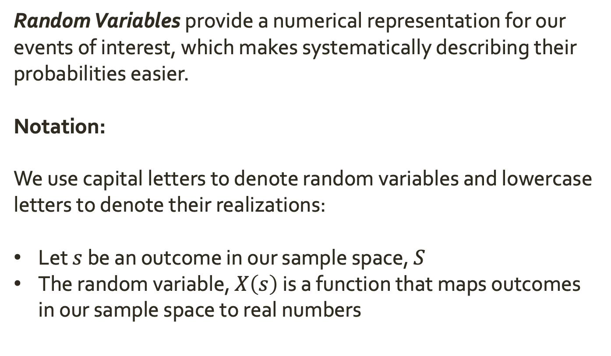
Random Variables
Random Variables provide a numerical representation for our events of interest, which makes systematically describing their probabilities easier.
Notation:
We use capital letters to denote random variables and lowercase letters to denote their realizations:
Let $s$ be an outcome in our sample space, $S$
The random variable, $X\left(s\right)$ is a function that maps outcomes in our sample space to real numbers

Slide 7
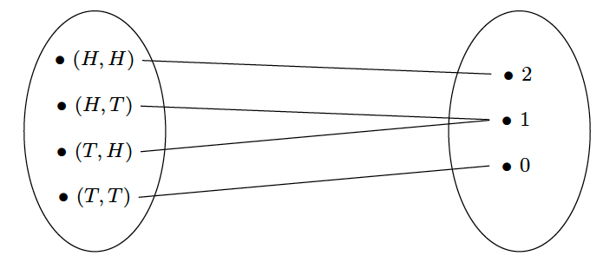
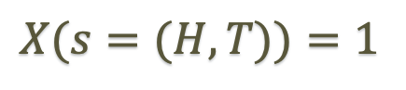
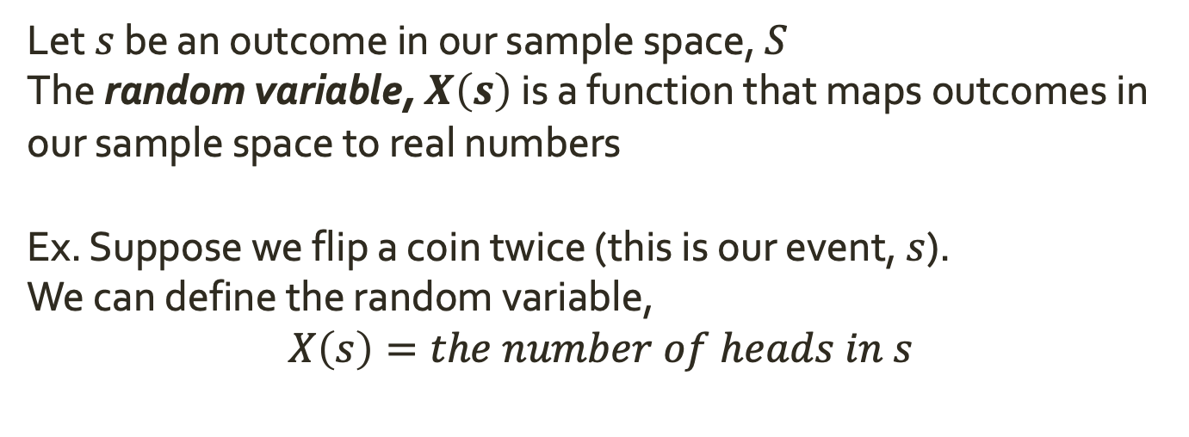
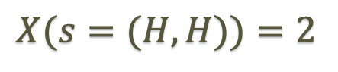
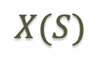

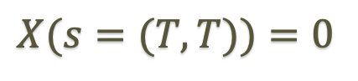
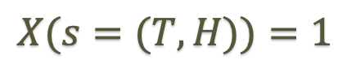
Random Variables
Let $s$ be an outcome in our sample space, $S$
The random variable, $X\left(s\right)$ is a function that maps outcomes in our sample space to real numbers
Ex. Suppose we flip a coin twice (this is our event, $s$).
We can define the random variable,
$$X\left(s\right)=the number of heads in s$$
$$S$$
$$X(S)$$
$$X(s=(H,H))=2$$
$$X(s=(H,T))=1$$
$$X(s=(T,H))=1$$
$$X(s=(T,T))=0$$

Slide 8
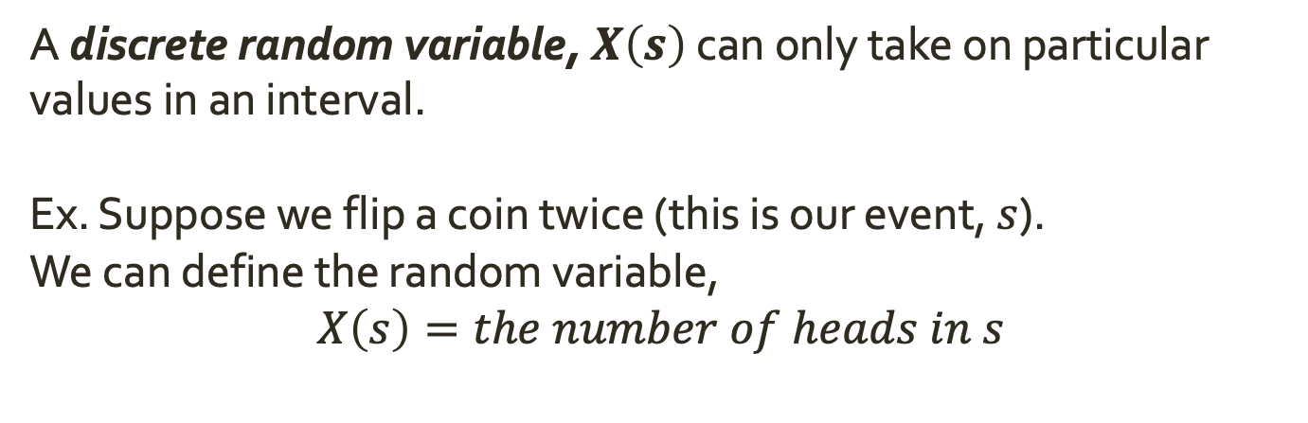
Discrete Random Variables
A discrete random variable, $X\left(s\right)$ can only take on particular values in an interval.
Ex. Suppose we flip a coin twice (this is our event, $s$).
We can define the random variable,
$$X\left(s\right)=the number of heads in s$$
$$S$$
$$X(S)$$
$$X(s=(H,H))=2$$
$$X(s=(H,T))=1$$
$$X(s=(T,H))=1$$
X can only be 0, 1, or 2
$$X(s=(T,T))=0$$

Slide 9
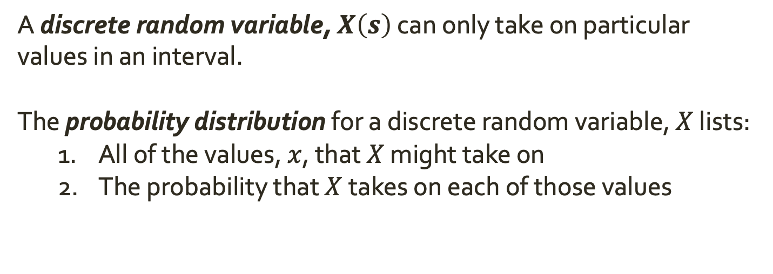
Discrete Random Variables
A discrete random variable, $X\left(s\right)$ can only take on particular values in an interval.
The probability distribution for a discrete random variable, $X$ lists:
All of the values, $x$, that $X$ might take on
The probability that $X$ takes on each of those values

Slide 10
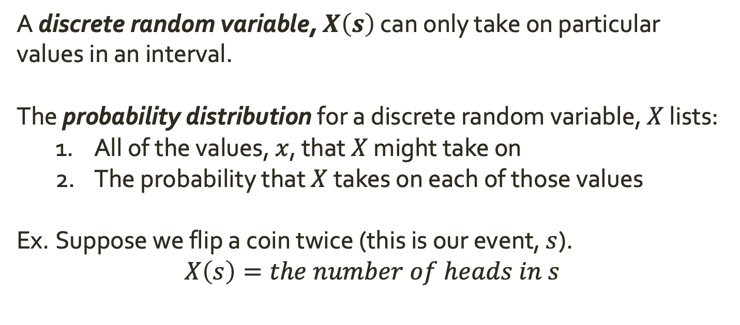
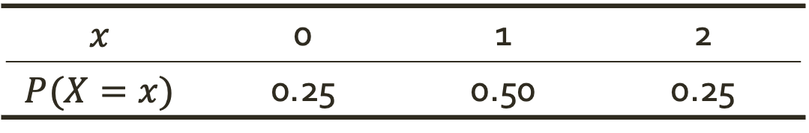
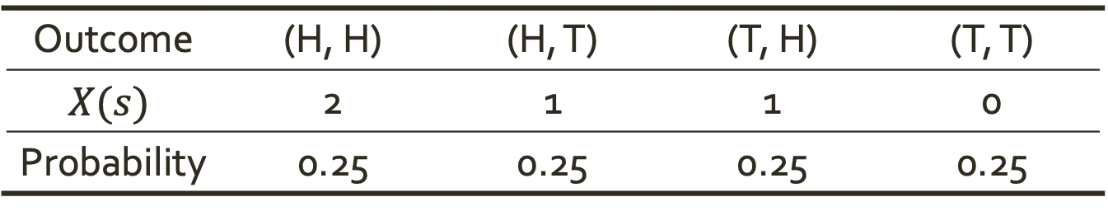
Discrete Random Variables
A discrete random variable, $X\left(s\right)$ can only take on particular values in an interval.
The probability distribution for a discrete random variable, $X$ lists:
All of the values, $x$, that $X$ might take on
The probability that $X$ takes on each of those values
Ex. Suppose we flip a coin twice (this is our event, $s$).
$$X\left(s\right)=the number of heads in s$$
Outcome | (H, H) | (H, T) | (T, H) | (T, T)
$$X(s)$$ | 2 | 1 | 1 | 0
Probability | 0.25 | 0.25 | 0.25 | 0.25
$$x$$ | 0 | 1 | 2
$$P(X=x)$$ | 0.25 | 0.50 | 0.25

Slide 11
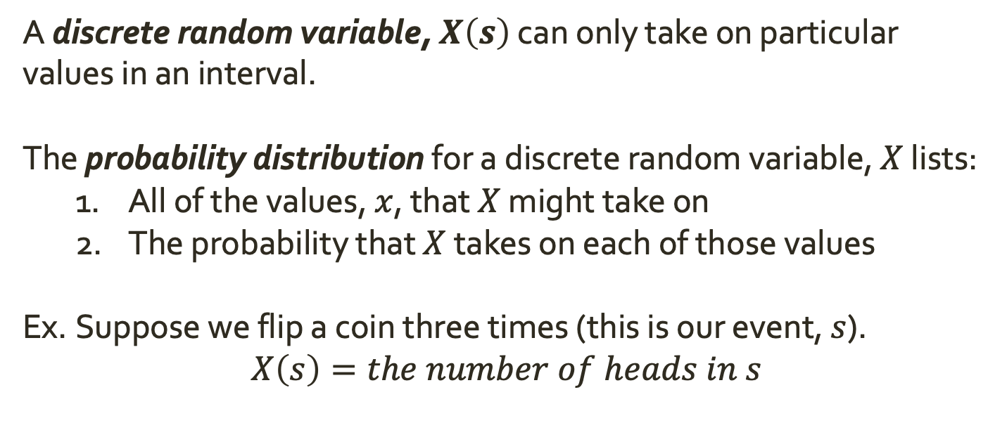
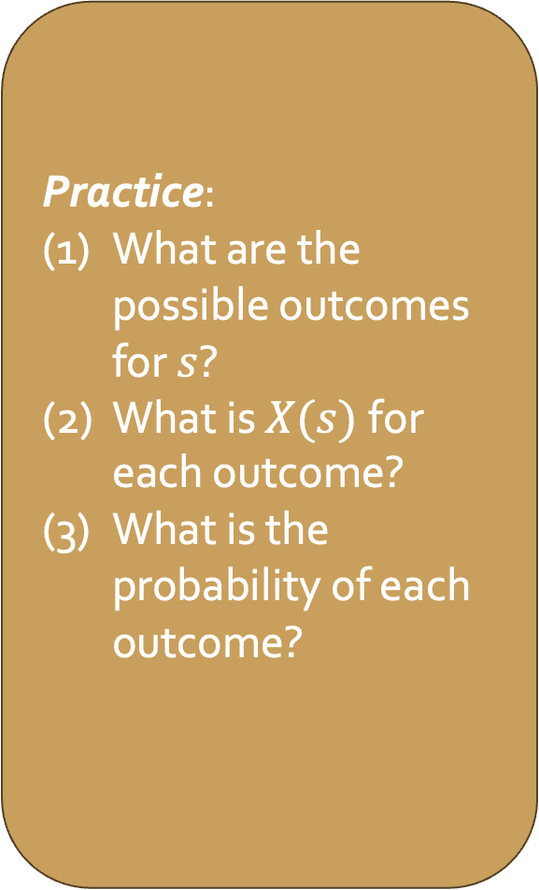
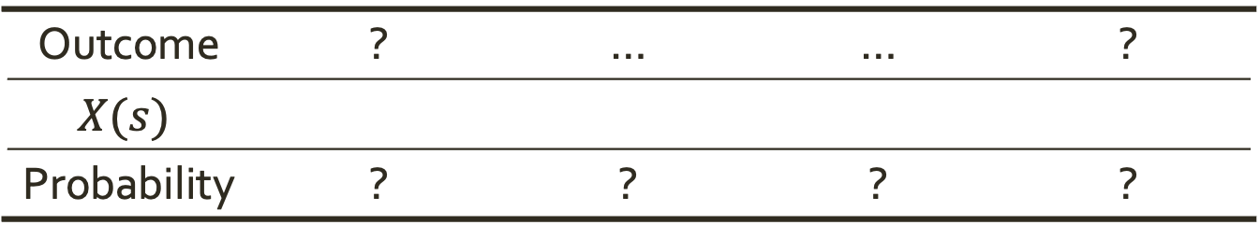
Discrete Random Variables
A discrete random variable, $X\left(s\right)$ can only take on particular values in an interval.
The probability distribution for a discrete random variable, $X$ lists:
All of the values, $x$, that $X$ might take on
The probability that $X$ takes on each of those values
Ex. Suppose we flip a coin three times (this is our event, $s$).
$$X\left(s\right)=the number of heads in s$$
Practice:
What are the possible outcomes for $s$?
What is $X(s)$for each outcome?
What is the probability of each outcome?
Outcome | ? | … | … | ?
$$X(s)$$
Probability | ? | ? | ? | ?

Slide 12
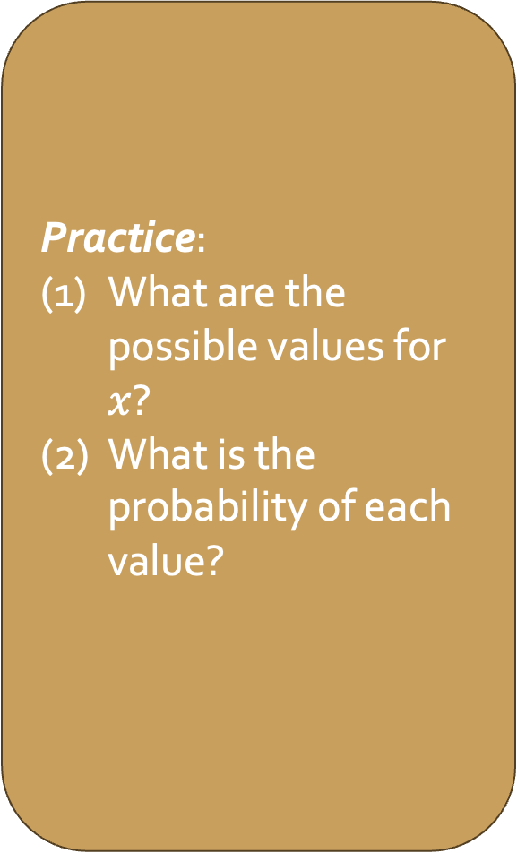
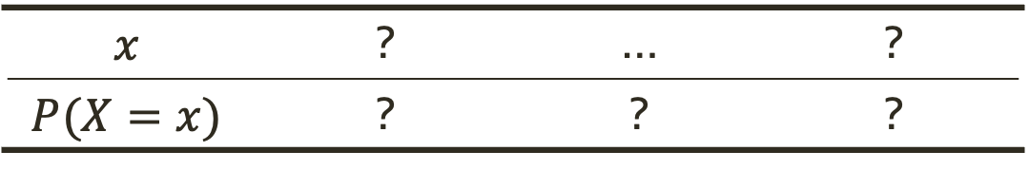
Discrete Random Variables
A discrete random variable, $X\left(s\right)$ can only take on particular values in an interval.
The probability distribution for a discrete random variable, $X$ lists:
All of the values, $x$, that $X$ might take on
The probability that $X$ takes on each of those values
Ex. Suppose we flip a coin three times (this is our event, $s$).
$$X\left(s\right)=the number of heads in s$$
Practice:
What are the possible values for $x$?
What is the probability of each value?
Outcome | ? | … | … | ?
$$X(s)$$
Probability | ? | ? | ? | ?
$$x$$ | ? | … | ?
$$P(X=x)$$ | ? | ? | ?

Slide 13
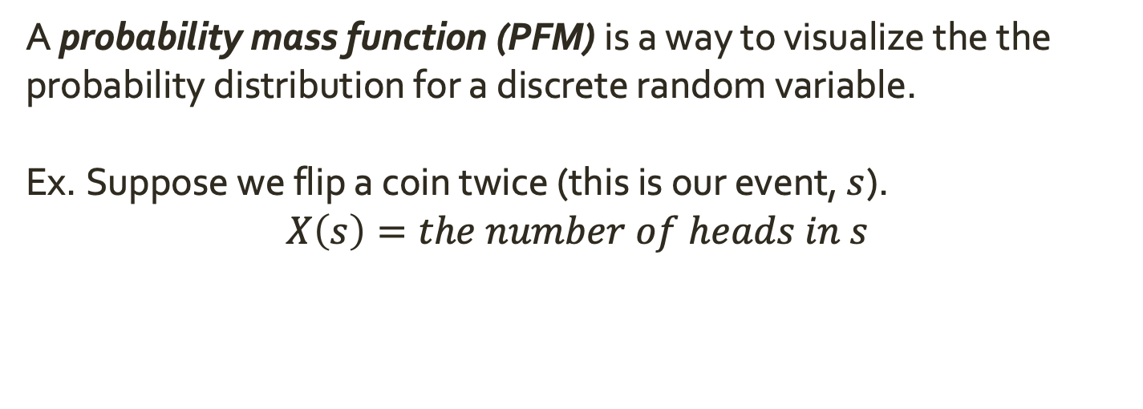
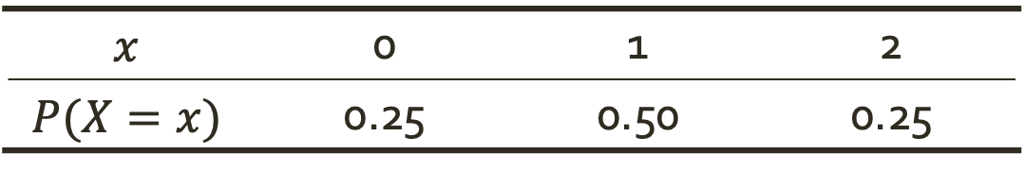
Probability Mass Functions
A probability mass function (PFM) is a way to visualize the the probability distribution for a discrete random variable.
Ex. Suppose we flip a coin twice (this is our event, $s$).
$$X\left(s\right)=the number of heads in s$$
$$x$$ | 0 | 1 | 2
$$P(X=x)$$ | 0.25 | 0.50 | 0.25

Slide 14
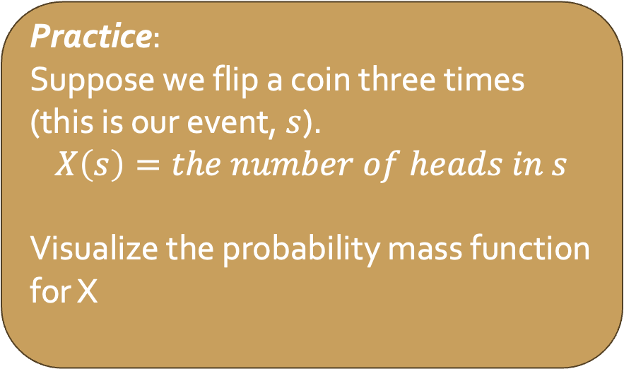
Probability Mass Functions
A probability mass function (PFM) is a way to visualize the the probability distribution for a discrete random variable.
Ex. Suppose we flip a coin twice (this is our event, $s$).
$$X\left(s\right)=the number of heads in s$$
$$x$$ | 0 | 1 | 2
$$P(X=x)$$ | 0.25 | 0.50 | 0.25
Practice:
Suppose we flip a coin three times (this is our event, $s$).
$$X\left(s\right)=the number of heads in s$$
Visualize the probability mass function for X

Slide 15
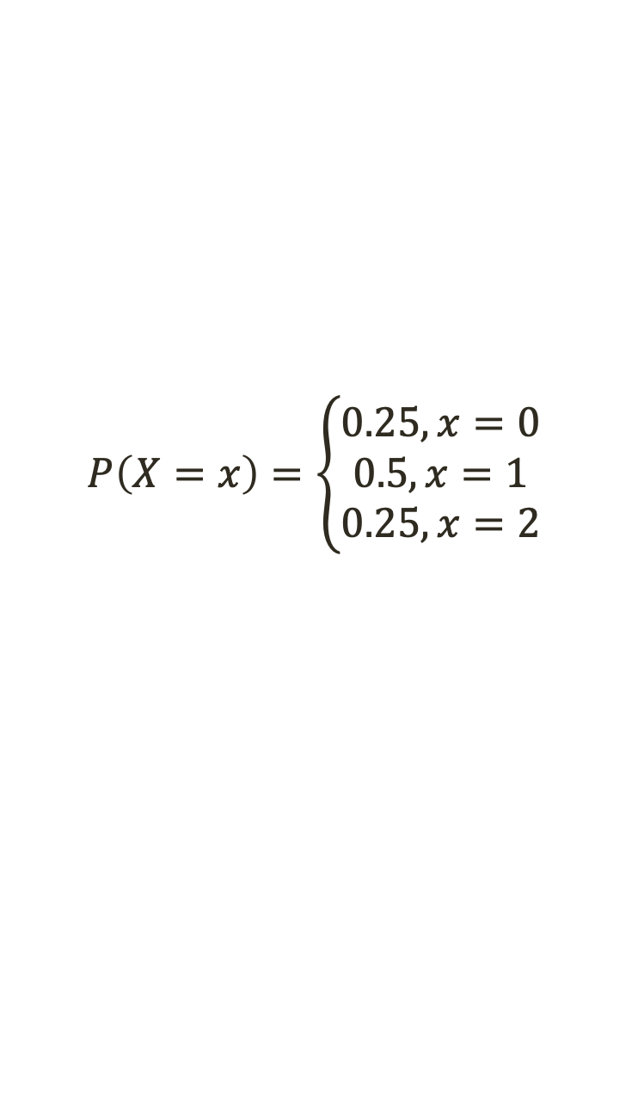
Probability Mass Functions
A probability mass function (PFM) is a way to visualize the the probability distribution for a discrete random variable.
Ex. Suppose we flip a coin twice (this is our event, $s$).
$$X\left(s\right)=the number of heads in s$$
$$x$$ | 0 | 1 | 2
$$P(X=x)$$ | 0.25 | 0.50 | 0.25
$$P\left(X=x\right)=\left\{\begin{aligned}0.25, x=0 \\ 0.5, x=1 \\ 0.25, x=2\end{aligned}\right.$$

Slide 16
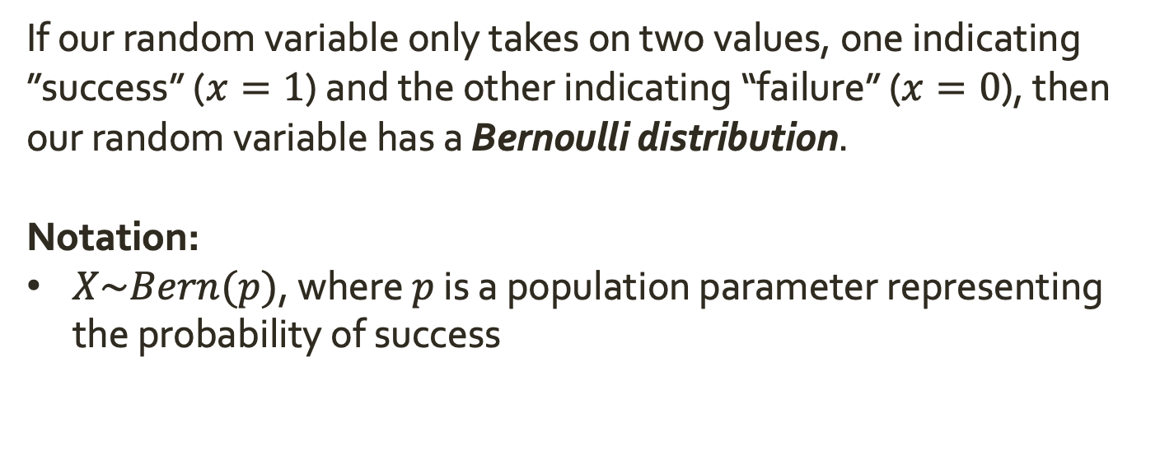
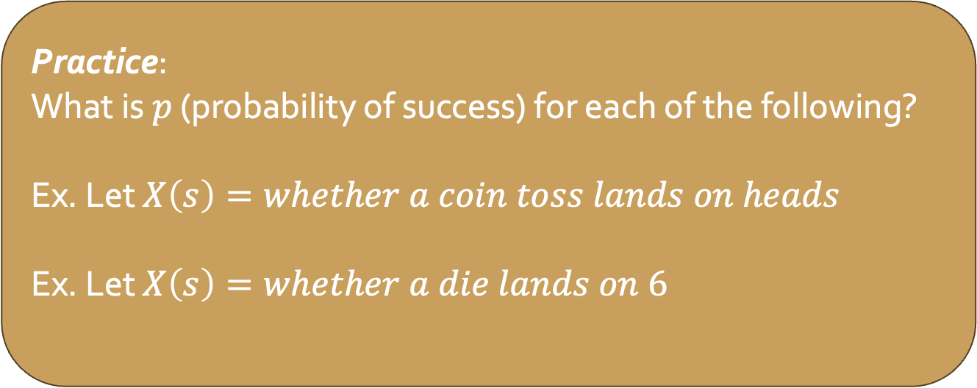
Bernoulli Distributions
If our random variable only takes on two values, one indicating ”success” ($x=1$) and the other indicating “failure” ($x=0$), then our random variable has a Bernoulli distribution.
Notation:
$X\sim Bern(p)$, where $p$ is a population parameter representing the probability of success
Practice:
What is $p$ (probability of success) for each of the following?
Ex. Let $X\left(s\right)=whether a coin toss lands on heads$
Ex. Let $X\left(s\right)=whether a die lands on 6$

Slide 17
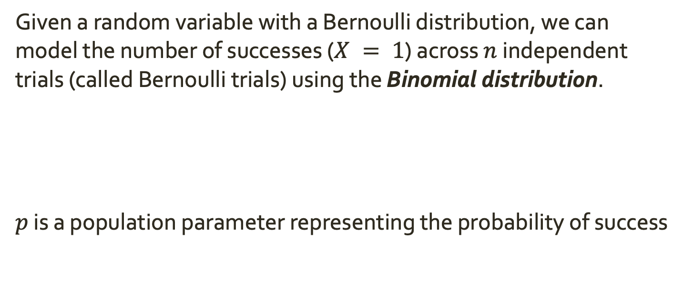
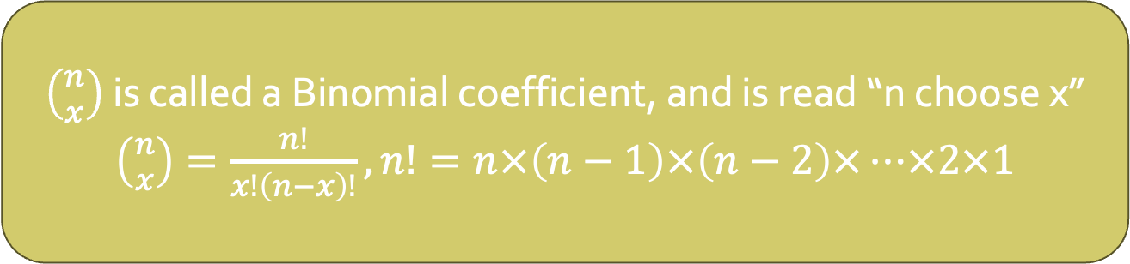

Bernoulli Distributions
Given a random variable with a Bernoulli distribution, we can model the number of successes ($X = 1$) across $n$ independent trials (called Bernoulli trials) using the Binomial distribution.
$p$ is a population parameter representing the probability of success
$$P\left(X=x\right)=\left({n \atop x}\right)p^{x}{\left(1−p\right)}^{n−x}$$
$\left({n \atop x}\right)$ is called a Binomial coefficient, and is read “n choose x”
$\left({n \atop x}\right)=\frac{n!}{x!\left(n−x\right)!}, n!=n×\left(n−1\right)×\left(n−2\right)×…×2×1$

Slide 18
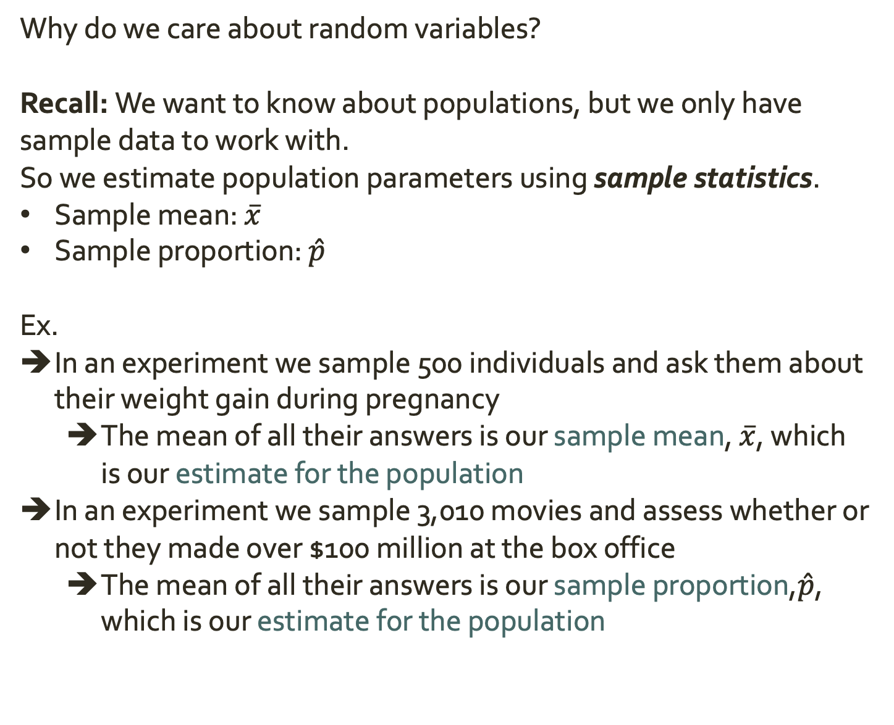
Random Variables and Statistics
Why do we care about random variables?
Recall: We want to know about populations, but we only have sample data to work with.
So we estimate population parameters using sample statistics.
Sample mean: $\overline{x}$
Sample proportion: $\hat{p}$
Ex.
In an experiment we sample 500 individuals and ask them about their weight gain during pregnancy
The mean of all their answers is our sample mean, $\overline{x}$, which is our estimate for the population
In an experiment we sample 3,010 movies and assess whether or not they made over $100 million at the box office
The mean of all their answers is our sample proportion,$\hat{p}$, which is our estimate for the population

Slide 19
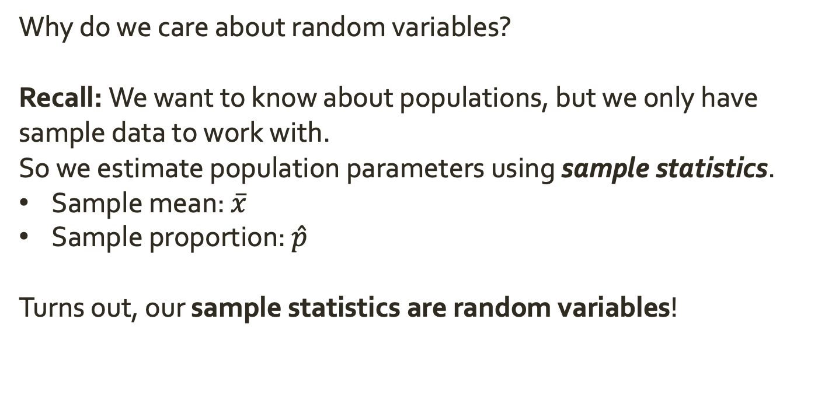
Random Variables and Statistics
Why do we care about random variables?
Recall: We want to know about populations, but we only have sample data to work with.
So we estimate population parameters using sample statistics.
Sample mean: $\overline{x}$
Sample proportion: $\hat{p}$
Turns out, our sample statistics are random variables!

Slide 20
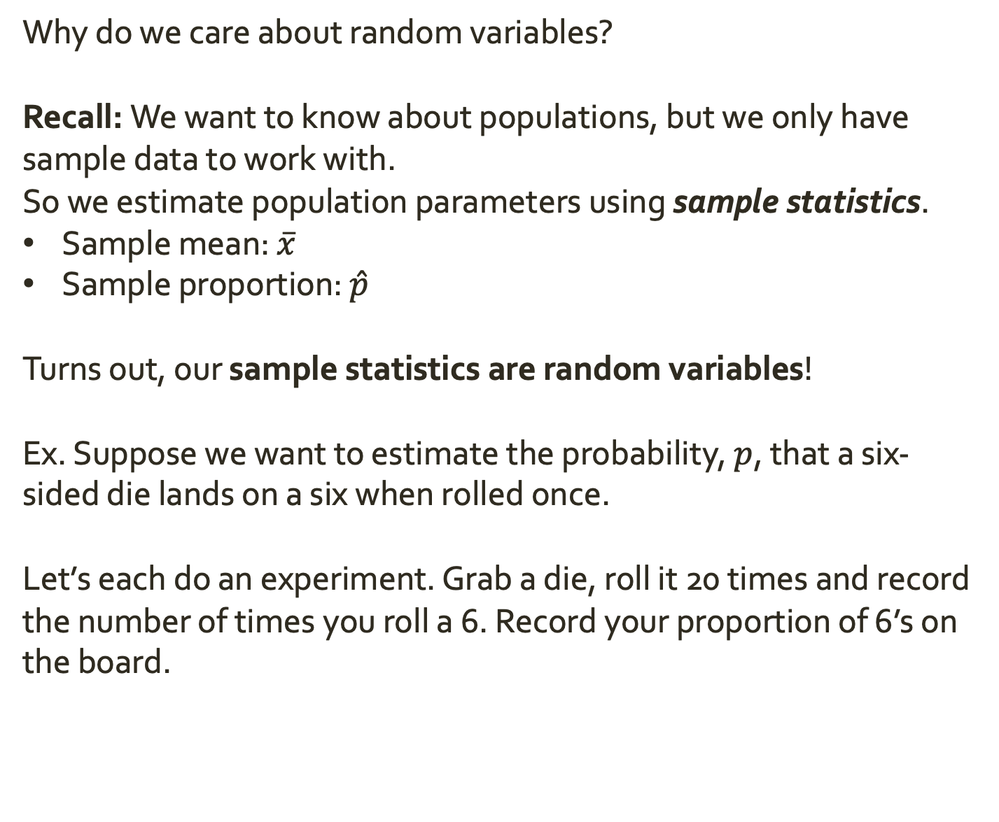
Random Variables and Statistics
Why do we care about random variables?
Recall: We want to know about populations, but we only have sample data to work with.
So we estimate population parameters using sample statistics.
Sample mean: $\overline{x}$
Sample proportion: $\hat{p}$
Turns out, our sample statistics are random variables!
Ex. Suppose we want to estimate the probability, $p$, that a six-sided die lands on a six when rolled once.
Let’s each do an experiment. Grab a die, roll it 20 times and record the number of times you roll a 6. Record your proportion of 6’s on the board.
Notes:
The proportion of 6’s is a random variable – it varies experiment to experiment, but ranges between 0 and 1
Let’s look at the outcome across experiments. Each had a sample size of 20 and was from my population of dice.
This histogram is a distribution for the possible outcomes of X given a sample size of 20. It tells us how our proportion is expected to var from one sample to another.

Slide 21
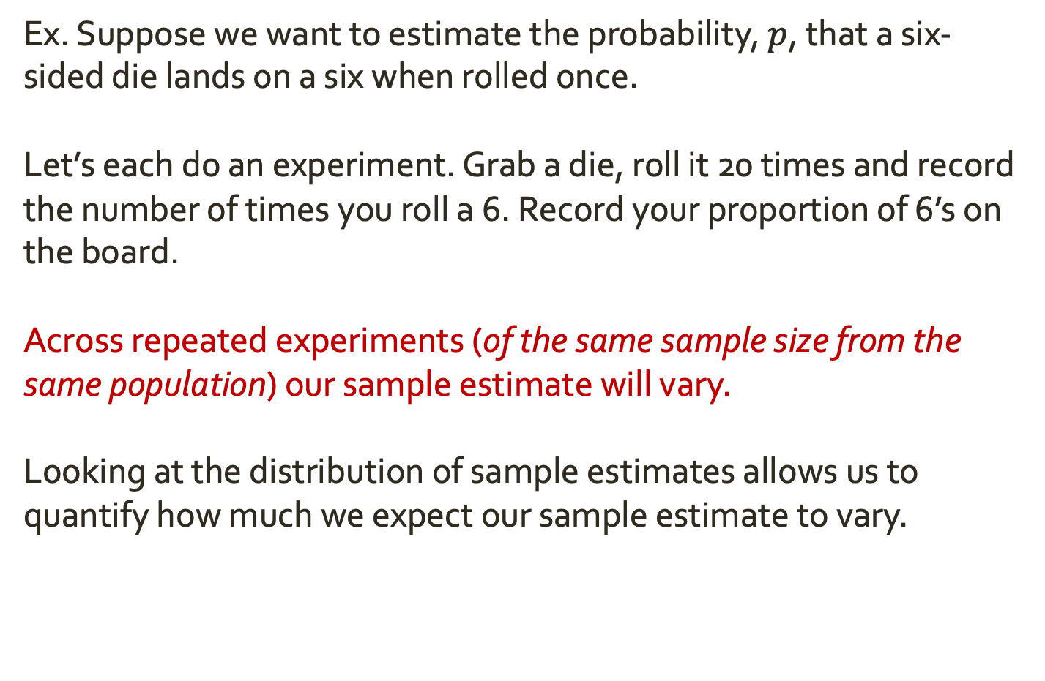
Random Variables and Statistics
Ex. Suppose we want to estimate the probability, $p$, that a six-sided die lands on a six when rolled once.
Let’s each do an experiment. Grab a die, roll it 20 times and record the number of times you roll a 6. Record your proportion of 6’s on the board.
Across repeated experiments (of the same sample size from the same population) our sample estimate will vary.
Looking at the distribution of sample estimates allows us to quantify how much we expect our sample estimate to vary.

Slide 22
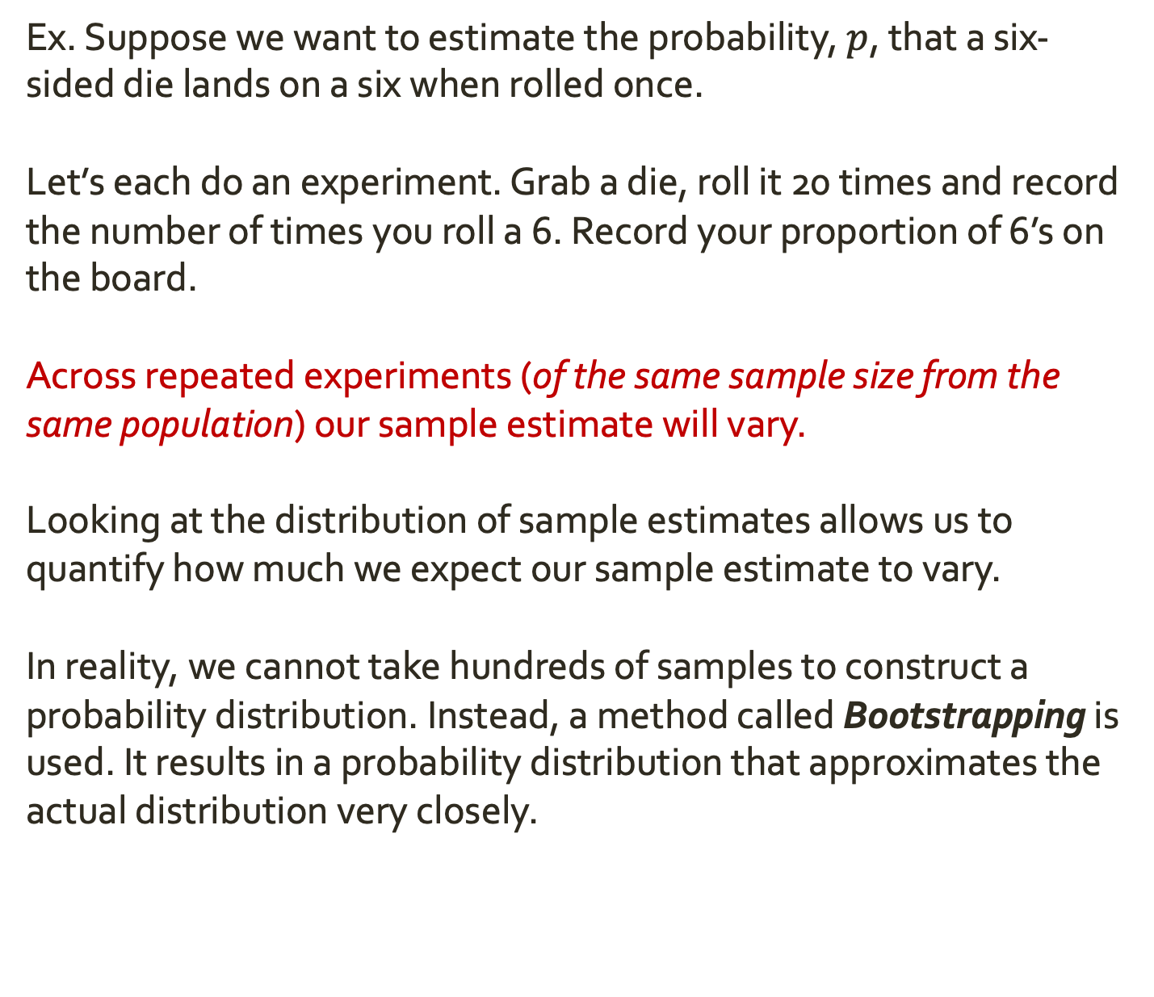
Random Variables and Statistics
Ex. Suppose we want to estimate the probability, $p$, that a six-sided die lands on a six when rolled once.
Let’s each do an experiment. Grab a die, roll it 20 times and record the number of times you roll a 6. Record your proportion of 6’s on the board.
Across repeated experiments (of the same sample size from the same population) our sample estimate will vary.
Looking at the distribution of sample estimates allows us to quantify how much we expect our sample estimate to vary.
In reality, we cannot take hundreds of samples to construct a probability distribution. Instead, a method called Bootstrapping is used. It results in a probability distribution that approximates the actual distribution very closely.

Slide 23
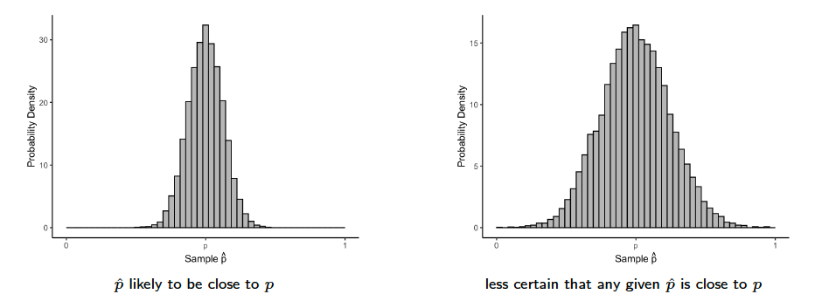
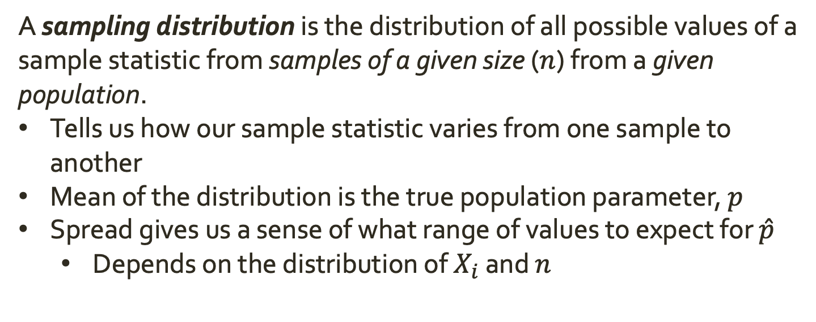
Sampling Distributions
A sampling distribution is the distribution of all possible values of a sample statistic from samples of a given size ($n$) from a given population.
Tells us how our sample statistic varies from one sample to another
Mean of the distribution is the true population parameter, $p$
Spread gives us a sense of what range of values to expect for $\hat{p}$
Depends on the distribution of $X_{i}$ and $n$

Slide 24
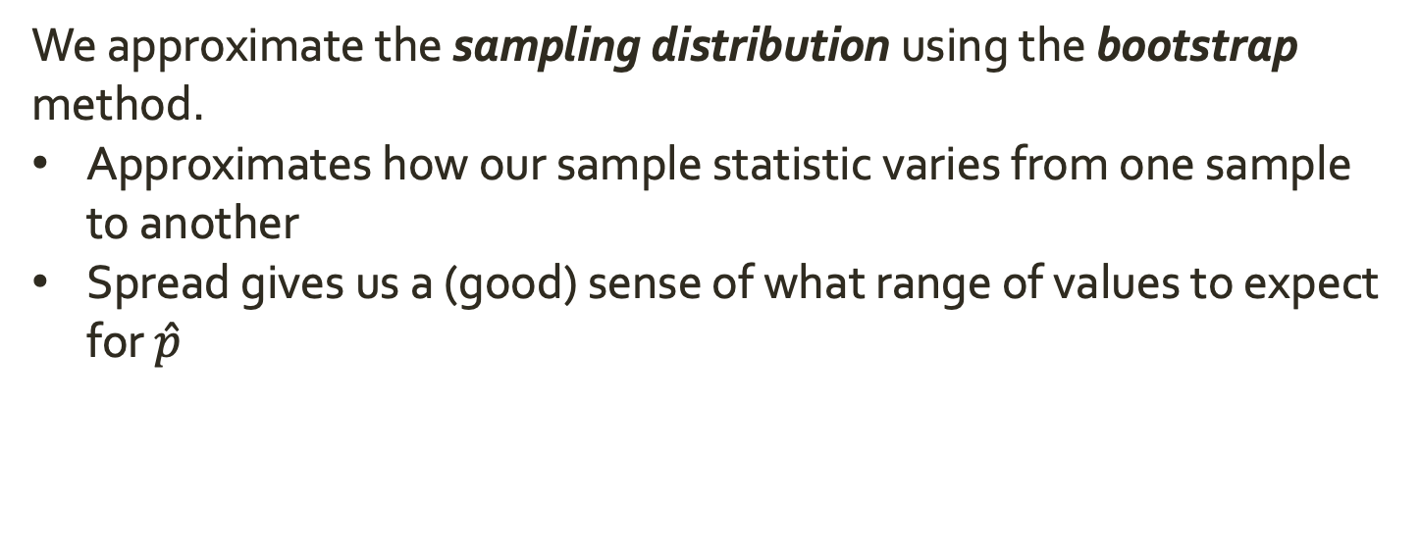
Sampling Distributions
We approximate the sampling distribution using the bootstrap method.
Approximates how our sample statistic varies from one sample to another
Spread gives us a (good) sense of what range of values to expect for $\hat{p}$

Slide 25
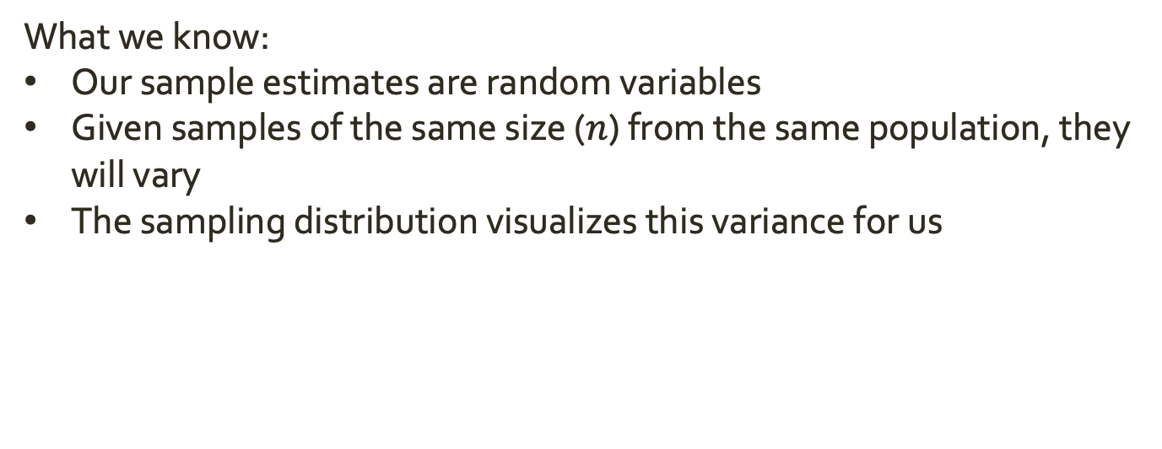
Recapping
What we know:
Our sample estimates are random variables
Given samples of the same size ($n$) from the same population, they will vary
The sampling distribution visualizes this variance for us

Slide 26
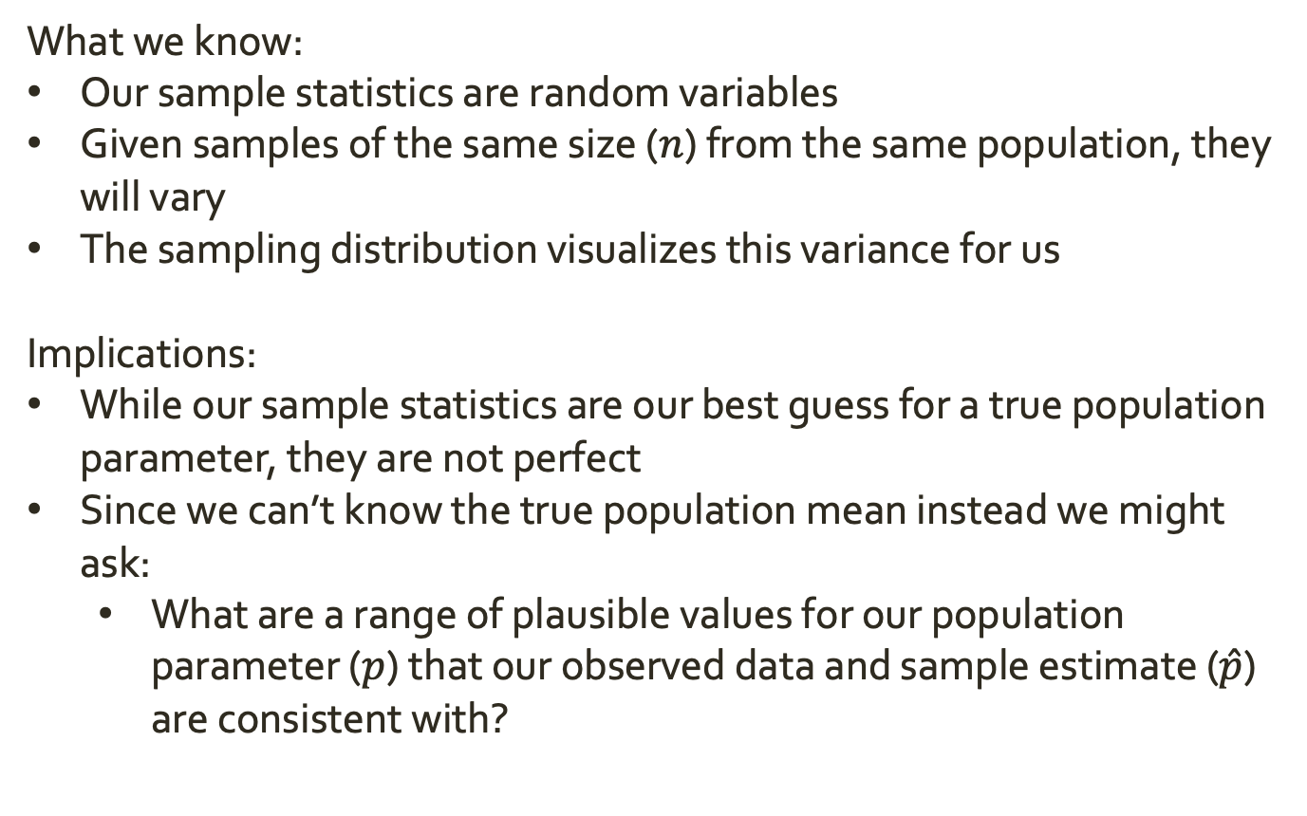
Recapping
What we know:
Our sample statistics are random variables
Given samples of the same size ($n$) from the same population, they will vary
The sampling distribution visualizes this variance for us
Implications:
While our sample statistics are our best guess for a true population parameter, they are not perfect
Since we can’t know the true population mean instead we might ask:
What are a range of plausible values for our population parameter ($p$) that our observed data and sample estimate ($\hat{p}$) are consistent with?

Slide 27


















Confidence Intervals
$$p$$
$$\hat{p}$$
With one estimate, I’m very unlikely to exactly hit the population parameter.
$$p$$
$$\hat{p}$$
$$\hat{p}$$
$$p$$
$$p$$
$$\hat{p}$$
$$p$$
$$\hat{p}$$
$$p$$
$$\hat{p}$$
$$\hat{p}$$
$$p$$
$$\hat{p}$$
$$p$$
$$p$$
$$\hat{p}$$
$$\hat{p}$$
$$p$$

Slide 28
Confidence Intervals
$$p$$
$$\hat{p}$$
With one estimate, I’m very unlikely to exactly hit the population parameter.
With a range of plausible values, I have a high chance of capturing the population parameter.
← Notice I only miss once
$$p$$
$$\hat{p}$$
$$\hat{p}$$
$$p$$
$$p$$
$$\hat{p}$$
$$p$$
$$\hat{p}$$
$$p$$
$$\hat{p}$$
$$\hat{p}$$
$$p$$
$$\hat{p}$$
$$p$$
$$p$$
$$\hat{p}$$
$$\hat{p}$$
$$p$$

Slide 29
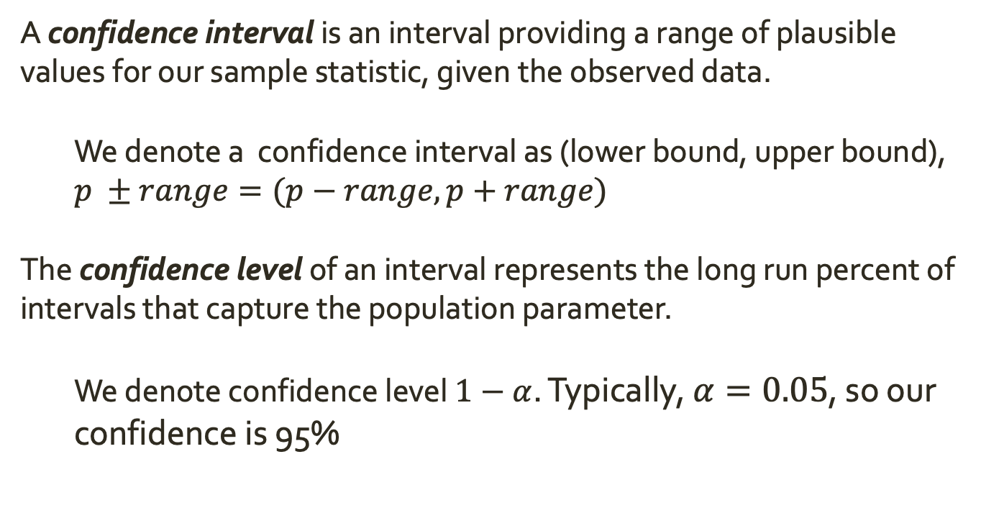
Confidence Intervals
A confidence interval is an interval providing a range of plausible values for our sample statistic, given the observed data.
We denote a confidence interval as (lower bound, upper bound),
$p ±range=(p−range, p+range)$
The confidence level of an interval represents the long run percent of intervals that capture the population parameter.
We denote confidence level $1−α$. Typically, $α=0.05$, so our confidence is 95%

Slide 30
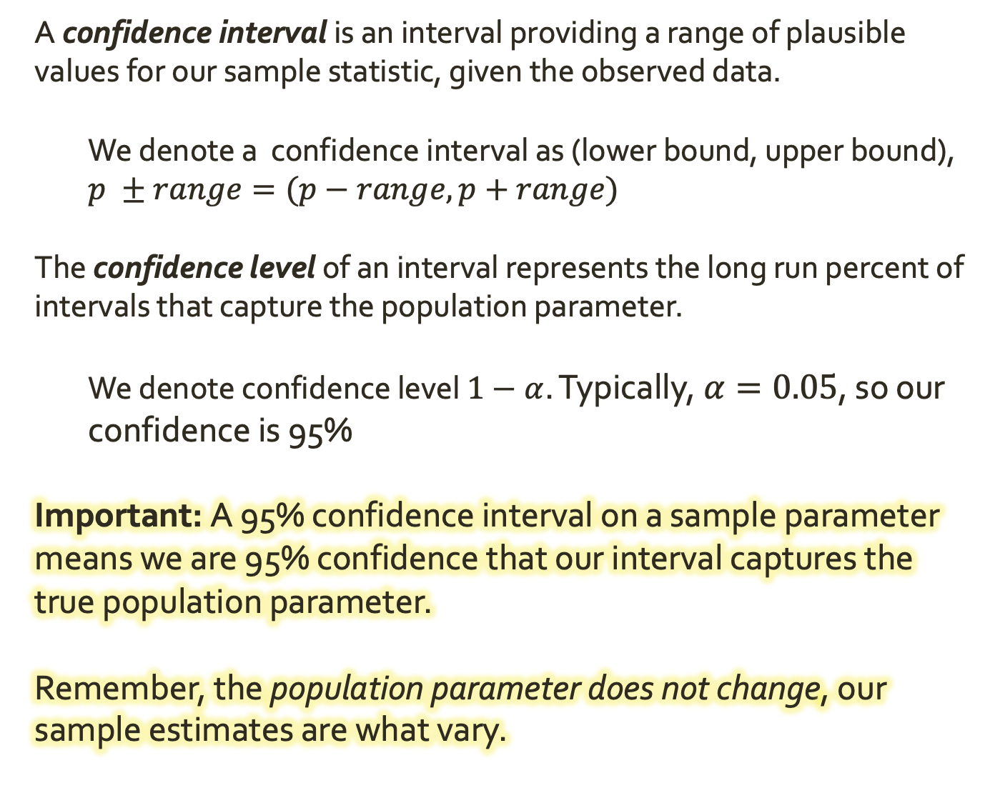
Confidence Intervals
A confidence interval is an interval providing a range of plausible values for our sample statistic, given the observed data.
We denote a confidence interval as (lower bound, upper bound),
$p ±range=(p−range, p+range)$
The confidence level of an interval represents the long run percent of intervals that capture the population parameter.
We denote confidence level $1−α$. Typically, $α=0.05$, so our confidence is 95%
Important: A 95% confidence interval on a sample parameter means we are 95% confidence that our interval captures the true population parameter.
Remember, the population parameter does not change, our sample estimates are what vary.

Slide 31
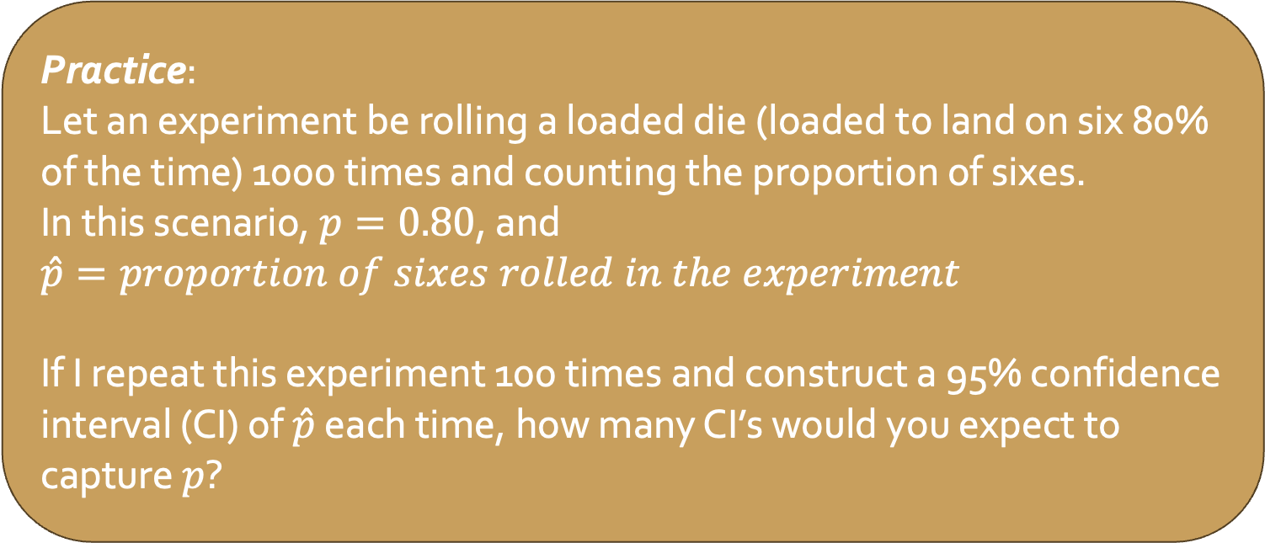
Confidence Intervals
Important: A 95% confidence interval on a sample parameter means we are 95% confidence that our interval captures the true population parameter.
Remember, the population parameter does not change, our sample estimates are what vary.
Practice:
Let an experiment be rolling a loaded die (loaded to land on six 80% of the time) 1000 times and counting the proportion of sixes.
In this scenario, $p=0.80$, and
$\hat{p}=proportion of sixes rolled in the experiment$
If I repeat this experiment 100 times and construct a 95% confidence interval (CI) of $\hat{p}$ each time, how many CI’s would you expect to capture $p$?

Slide 32
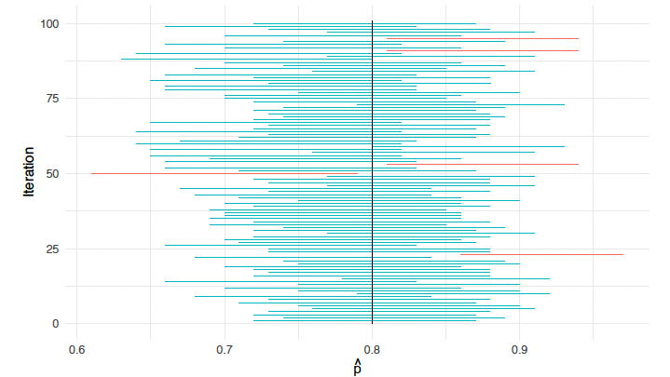
Confidence Intervals
Important: A 95% confidence interval on a sample parameter means we are 95% confidence that our interval captures the true population parameter.
Remember, the population parameter does not change, our sample estimates are what vary.

Slide 33
Confidence Intervals
Important: A 95% confidence interval on a sample parameter means we are 95% confidence that our interval captures the true population parameter.
Remember, the population parameter does not change, our sample estimates are what vary.
Practice:
Would you expect a 90% confidence interval to capture the population parameter more or less often than a 95% one?
What about an 80% confidence interval? A 99% one?
Would all of these intervals be equally useful to you?
Notes:
Bigger number == more sure (wider interval) but less useful

Slide 34
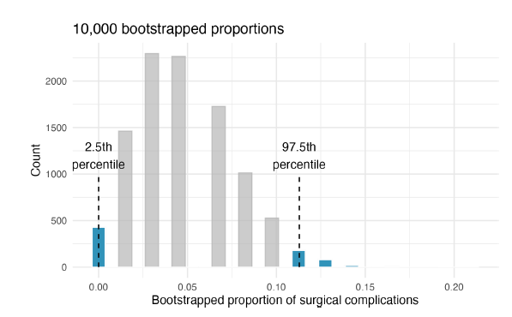
Confidence Intervals
Finding the 95% confidence interval for an estimate
Using the boostrapped distribution for our sample estimate, id the 2.5th percentile and 97.5th percentile of sample estimates
These are less likely estimates that are far from the mean
Notes:
Bigger == more sure but less useful

Slide 35
Confidence Intervals
Finding the 95% confidence interval for an estimate
Using the boostrapped distribution for our sample estimate, id the 2.5th percentile and 97.5th percentile of sample estimates
These are less likely estimates that are far from the mean
The remaining 95% of estimates are our confidence interval
We are 95% confident that the true proportion is between 0% and 11.3%
95% most likely values
0.113
Notes:
Bigger == more sure but less useful

Slide 36
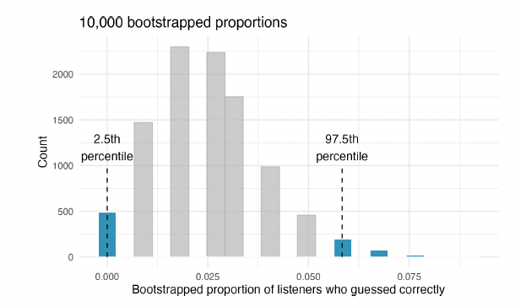
Confidence Intervals
Finding the 95% confidence interval for an estimate
Using the boostrapped distribution for our sample estimate, id the 2.5th percentile and 97.5th percentile of sample estimates
These are less likely estimates that are far from the mean
The remaining 95% of estimates are our confidence interval
Practice:
What is the 95% CI?
0.058
Notes:
Bigger == more sure but less useful

Slide 37
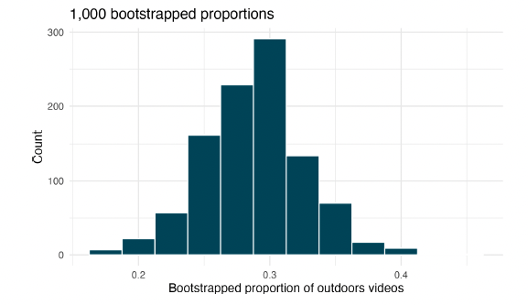
Confidence Intervals
Finding the 95% confidence interval for an estimate
Using the boostrapped distribution for our sample estimate, id the 2.5th percentile and 97.5th percentile of sample estimates
These are less likely estimates that are far from the mean
The remaining 95% of estimates are our confidence interval
Practice:
What is the 90% CI?
Notes:
0.22, 0.35

Slide 38
Confidence Intervals
Practice: Teens were surveyed about cyberbullying, and 54% to 64% reported experiencing cyberbullying (95% confidence interval). Answer the following questions based on this interval. (Pew Research Center, 2018)
a. A newspaper claims that a majority of teens have experienced cyberbullying. Is this claim supported by the confidence interval? Explain your reasoning.
b. A researcher conjectured that 70% of teens have experienced cyberbullying. Is this claim supported by the confidence interval? Explain your reasoning.
c. Without actually calculating the interval, determine if the claim of the researcher from part (b) would be supported based on a 90% confidence interval?
Notes:
90 would be more narrow

